Slide 1

Elasticsearch,
You know, for search! and more!
Medcl, Philips Kokoh Prasetyo, Arinto Murdopo, Casey Vu

Slide 2

Who am I?
Medcl，曾勇（Zeng Yong）
Developer/Evangelist @ Elastic
Follow Elasticsearch Since v0.5,2010
Joined Elastic Since September,2015
@medcl
medcl@elastic.co
http://github.com/medcl
Based in Changsha, Hunan, China

Slide 3
Changsha, What is this place?
Nobody
Some guy sitting behind

Slide 4


Slide 5
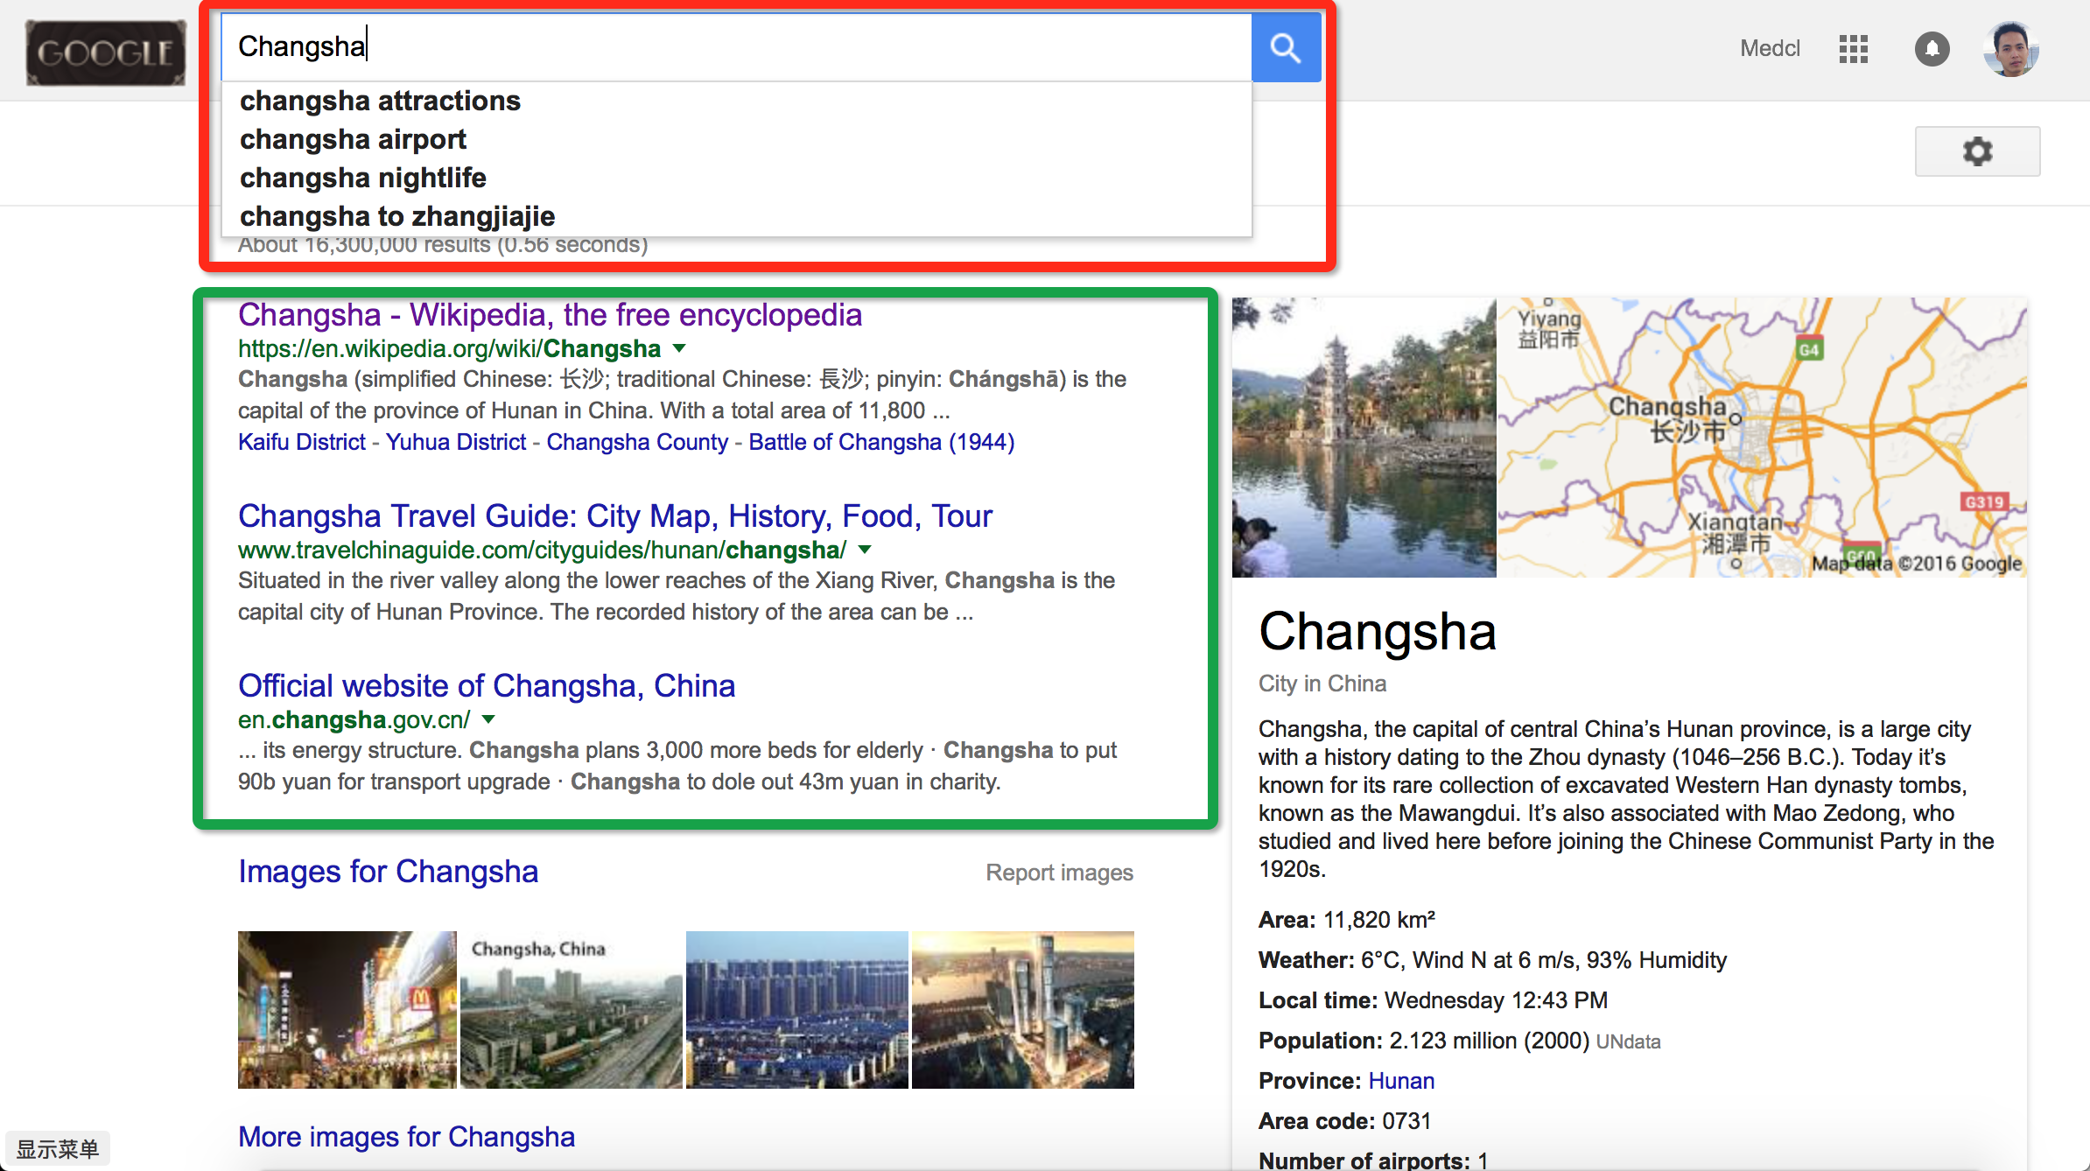
Notes:
Github is using elasticsearch

Slide 6
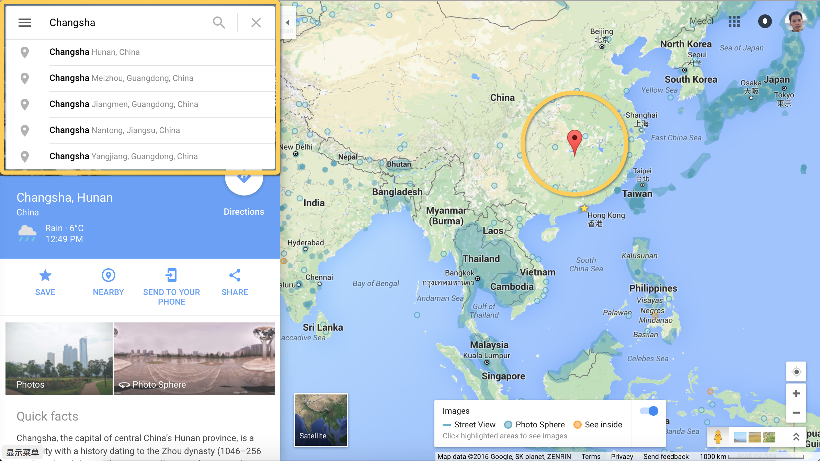
Notes:
Github is using elasticsearch

Slide 7
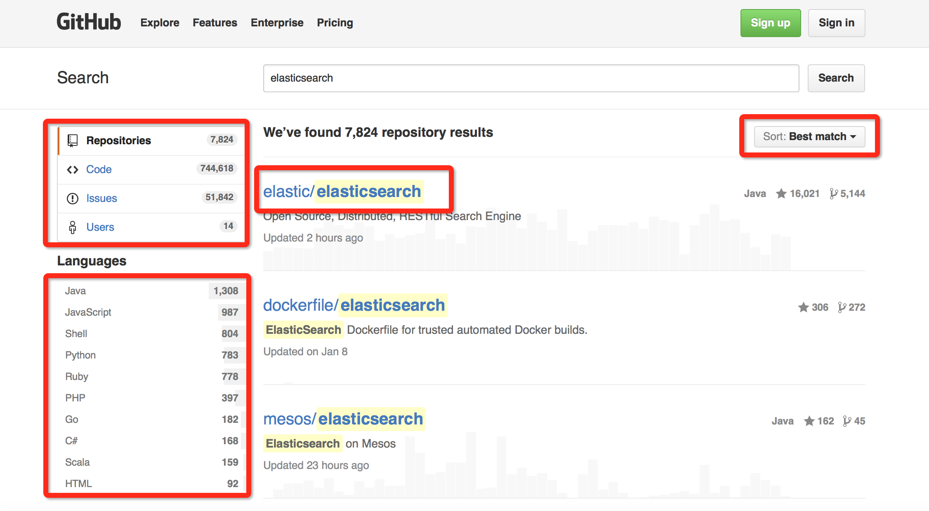
Notes:
Github is using elasticsearch

Slide 8

What is Elasticsearch?

Slide 9
Elasticsearch is an open source, distributed, scalable, highly available, document-oriented, RESTful, full text search engine with real-time search and analytics capabilities

Slide 10


Slide 11


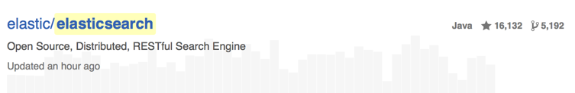
Elasticsearch is…
Elasticsearch is an open source, distributed, scalable, highly available, document-oriented, RESTful, full text search engine with real-time search and analytics capabilities
Apache 2.0 License
https://www.apache.org/licenses/LICENSE-2.0
Notes:
Do you love open source?

Slide 12

Elasticsearch is…
Elasticsearch is an open source, distributed, scalable, highly available, document-oriented, RESTful, full text search engine with real-time search and analytics capabilities
1
2
3
4
5
Index
Create a Index with have 5 shards
Notes:
glossary
Node： a running elasticsearch instance (JVM process)
Cluster：a group of nodes
Shard：
a part of an index
a Lucene index under the hood
primary: unique in the cluster
replica: one or more copy of the primary

Slide 13
Elasticsearch is…
Elasticsearch is an open source, distributed, scalable, highly available, document-oriented, RESTful, full text search engine with real-time search and analytics capabilities
Thomson Reuters: “107 clusters ~1747 nodes” @Elastic{ON}16
https://speakerdeck.com/elastic/thomson-reuters-research-journalism-finance-and-elastic
Netflix：”~150 clusters totaling ~3,500 instances hosting ~1.3 PB of data”
http://techblog.netflix.com/2016/02/evolution-of-netflix-data-pipeline.html?m=1

Slide 14

Elasticsearch is…
Elasticsearch is an open source, distributed, scalable, highly available, document-oriented, RESTful, full text search engine with real-time search and analytics capabilities
Notes:
We have replica on other machine to keep data safe

Slide 15

Elasticsearch is…
Elasticsearch is an open source, distributed, scalable, highly available, document-oriented, RESTful, full text search engine with real-time search and analytics capabilities
{
“title” : “Elasticsearch: You know, for search! and more!”,
“room” : “Level 3, Fermi Hall”,
“speakers” :[“Medcl”,“Philips Kokoh Prasetyo”],
“location” : {
“lat” : 1.3329,
“lon”: 103.7358
}
}
This is a document!

Slide 16
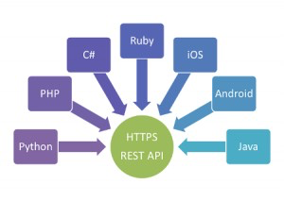
Elasticsearch is…
Elasticsearch is an open source, distributed, scalable, highly available, document-oriented, RESTful, full text search engine with real-time search and analytics capabilities
Endpoint
Index
Type
ID
curl –XPOST localhost:9200/fossasia/user/10 –d‘
{
“name”: “Medcl”,
“gender”: “male”,
“mail”: “medcl@elastic.co”
}
’
Document
Notes:
Database table row id

Slide 17

Elasticsearch is…
Elasticsearch is an open source, distributed, scalable, highly available, document-oriented, RESTful, full text search engine with real-time search and analytics capabilities
Notes:
Auto suggest
Text analysis

Slide 18
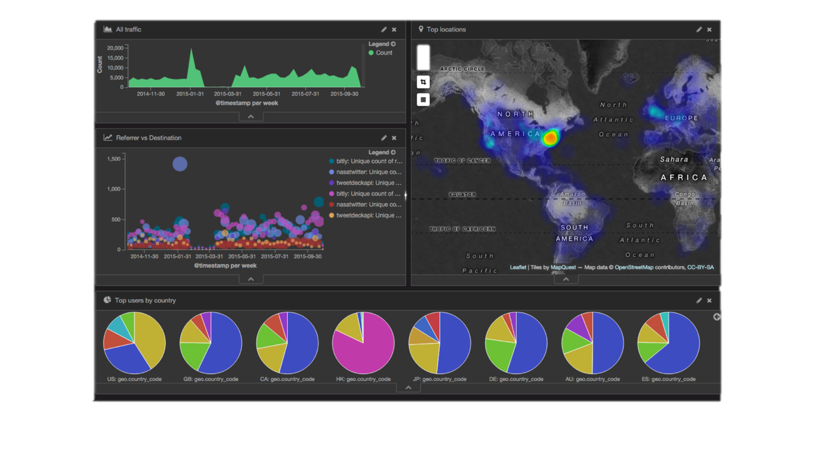
Elasticsearch is…
Elasticsearch is an open source, distributed, scalable, highly available, document-oriented, RESTful, full text search engine with real-time search and analytics capabilities
Real-time analytics
Time series data analytics
Log analysis
Security analytics
Fraud detection
Prediction modeling
Recommendations

Slide 19
How do we use it?

Slide 20
Up & Run
1. Download
http://download.elastic.co
2. Unzip
3. Run:
./bin/elasticsearch
bin/elasticsearch.bat

Slide 21
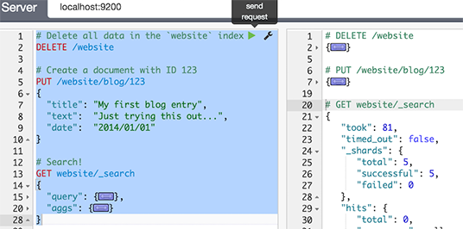
Tools first
Install kibana （download and unzip！http://github.com/elastic/kibana ）
./bin/kibana plugin --install elastic/sense
Notes:
Did I missed how to install Elasticsearch?

Slide 22
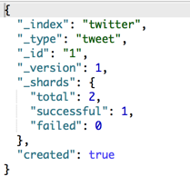
CRUD
Indexing
POST twitter/tweet/1
{
"user":"medcl",
"message":"elasticsearch is awesome!"
}

Slide 23
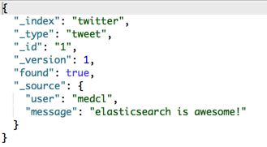
CRUD
Retrieving
GET twitter/tweet/1

Slide 24
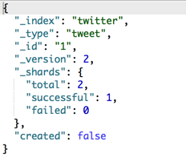
CRUD
Updating
PUT twitter/tweet/1
{
"user":"medcl",
"message": "elasticsearch is awesome! ",
"date": "2015-03-20 12:00:00"
}

Slide 25
CRUD
Deleting
DELETE twitter/tweet/1

Slide 26
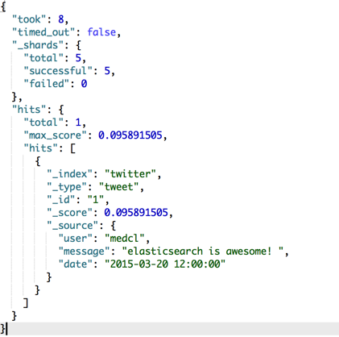
CRUD
Search
GET twitter/tweet/_search?q=elasticsearch

Slide 27
CRUD
Search
POST twitter/tweet/_search
{
"query": {
"match": {
"user": "medcl"
}
}
}

Slide 28
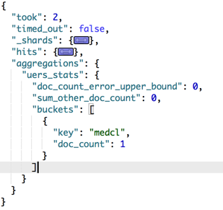
CRUD
Aggregation
POST twitter/tweet/_search
{
"query" : {
...
},
"aggs" : {
"uers_stats" : {
"terms" : { "field" : "user" }
}
}
}

Slide 29





The Elastic Stack
Monitoring
Plugins
Your plugins
User
Interface
Store, Index,
& Analyze
Ingest
V5 is coming! http://elastic.co/v5

Slide 30

Community
Code: http://github.com/elastic/
Forum: http://discuss.elastic.co
Download: https://www.elastic.co/downloads
Blog: https://www.elastic.co/blog
Meetup: http://www.meetup.com/ElasticsearchSG/
IRC: #elasticsearch, #logstash, #kibana, #beats
Follow us on Twitter @elastic

